Slide 1



Analyzing The Job Market
View in Power BI
Last data refresh:
1/9/2024 8:45:35 AM UTC
Downloaded at:
1/11/2024 8:32:46 AM UTC

Slide 2
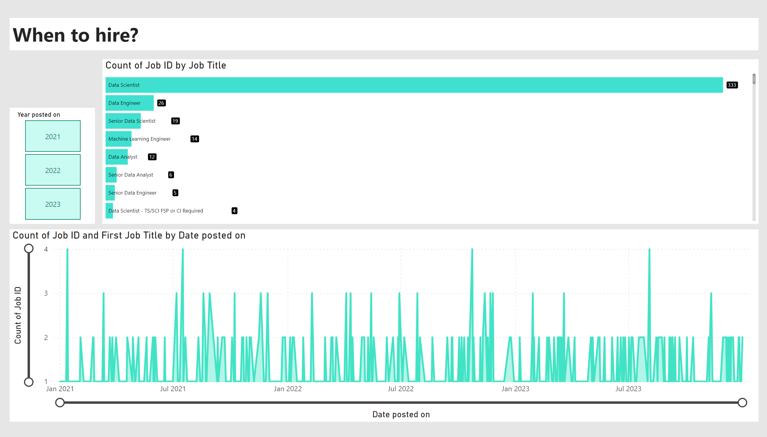
When?
Notes:
areaChart
No alt text provided
BarChartF5983CEA542C47889C9DE852B430DE5F
No alt text provided
textbox
No alt text provided
slicer
No alt text provided

Slide 3
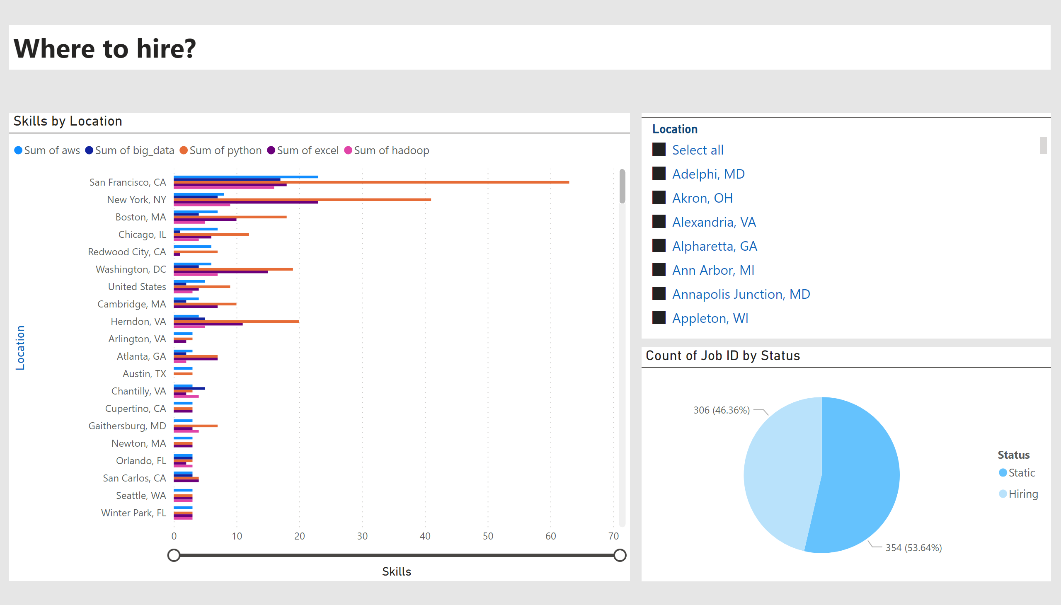
Where?
Notes:
textbox
No alt text provided
pieChart
No alt text provided
Skills by Location
No alt text provided
slicer
No alt text provided

Slide 4
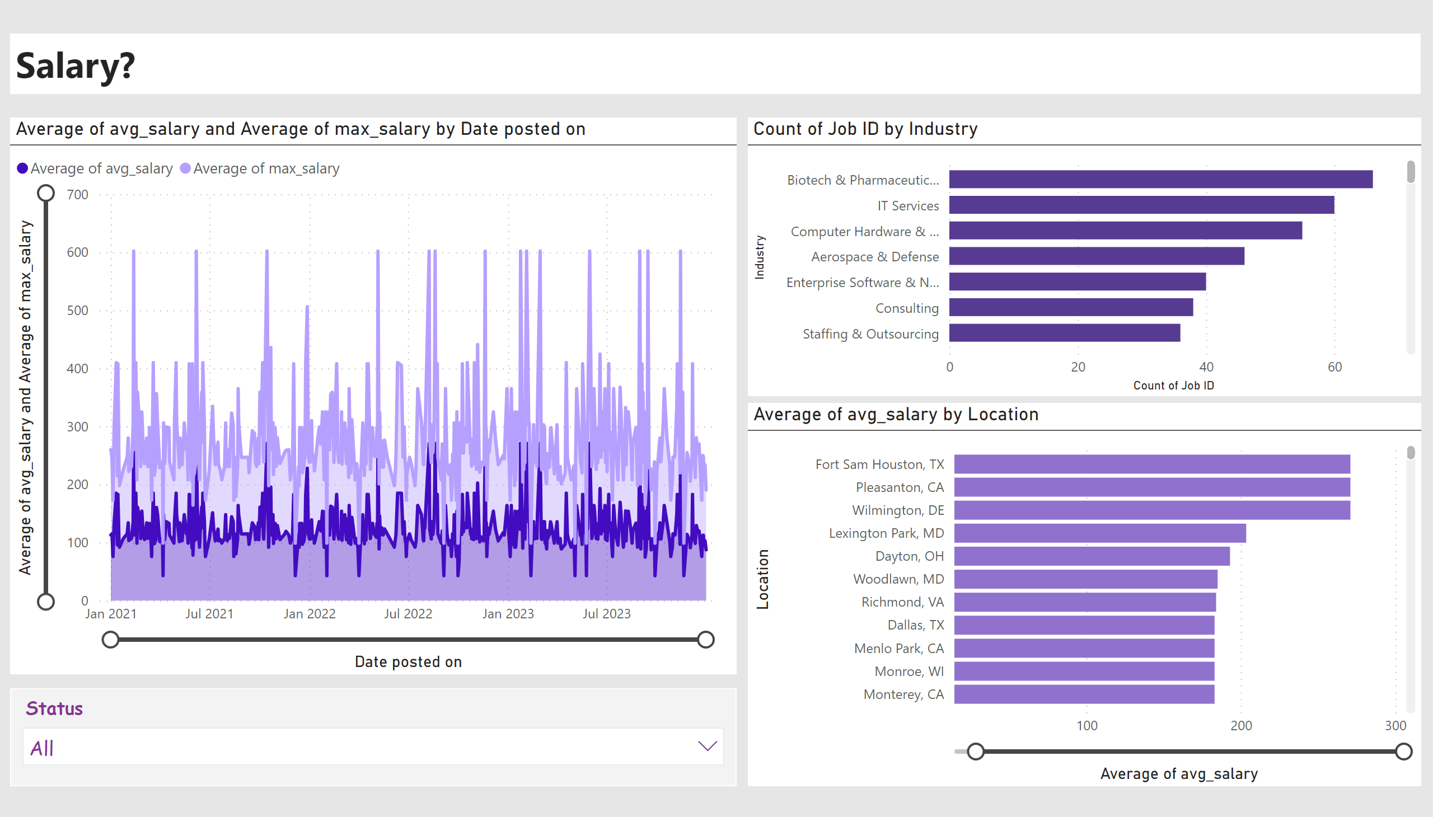
Salary?
Notes:
slicer
No alt text provided
clusteredBarChart
No alt text provided
clusteredBarChart
No alt text provided
textbox
No alt text provided
stackedAreaChart
No alt text provided

Slide 5
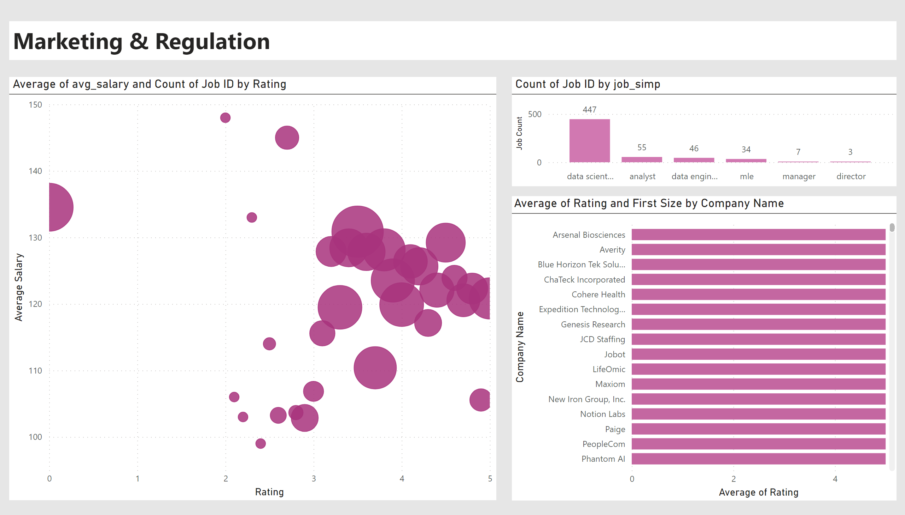
Marketing & Regulation
Notes:
scatterChart
No alt text provided
columnChart
No alt text provided
barChart
No alt text provided
textbox
No alt text provided

Slide 6
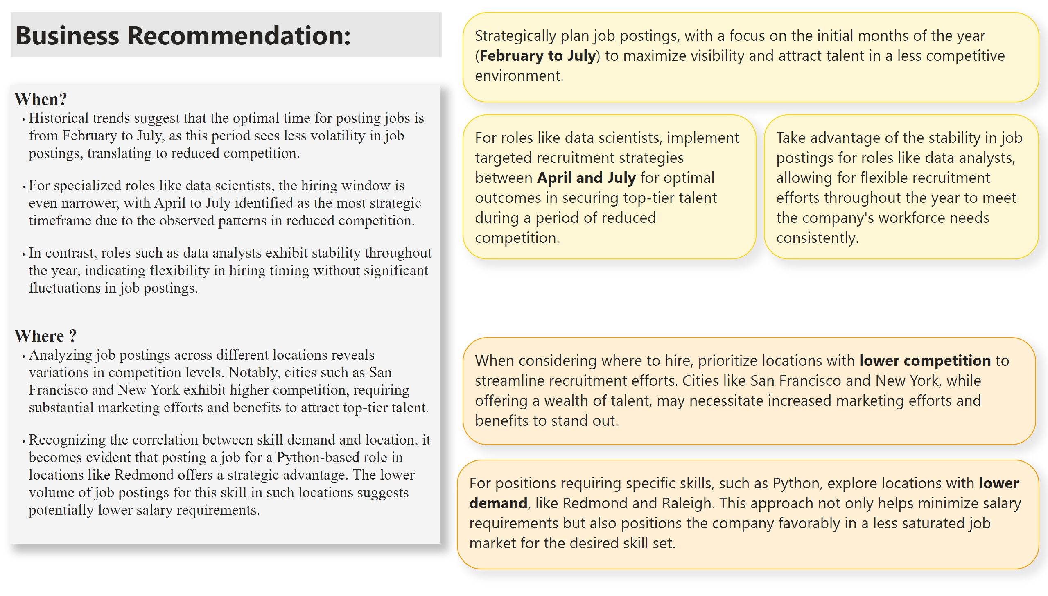
Recommendation 1
Notes:
textbox
No alt text provided
textbox
No alt text provided
textbox
No alt text provided
textbox
No alt text provided
textbox
No alt text provided
textbox
No alt text provided
textbox
No alt text provided

Slide 7
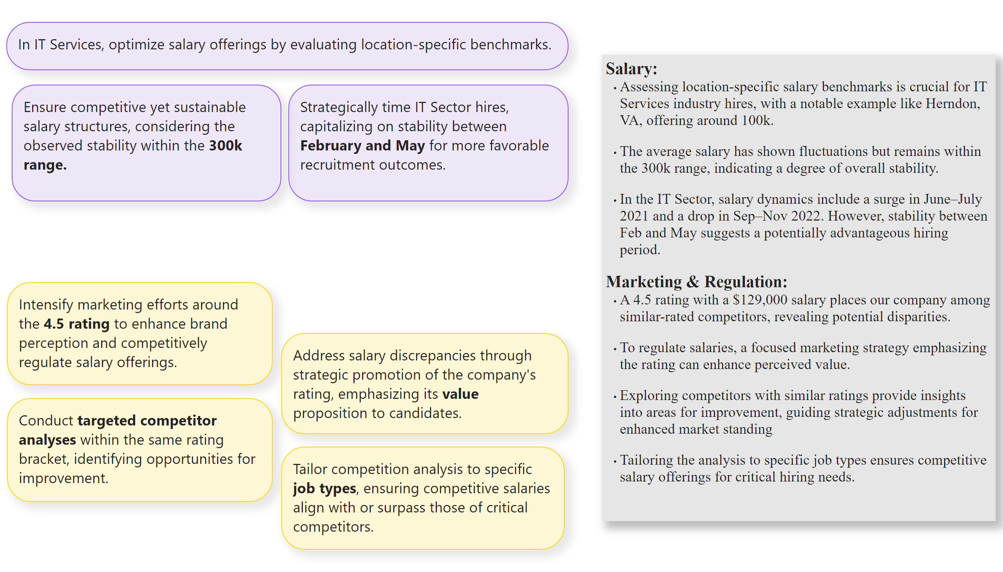
Recommendation 2
Notes:
textbox
No alt text provided
textbox
No alt text provided
textbox
No alt text provided
textbox
No alt text provided
textbox
No alt text provided
textbox
No alt text provided
textbox
No alt text provided
textbox
No alt text provided

